Slide 1
Mapping Value
Pros & Cons of the Manufacturing Paradigm
Are you curious?
Rob England
Two Hills
@theitskeptic
Mark Whiting
ValueFlow
@markwhitingau

Slide 2

Three key points
Our systems are complex
Complex work flows in networks
Complex systems require flexible work
Notes:
Our systems are complex
Sometimes simple standard prepared procedures
Sometimes complicated can assemble practice drills together
Sometimes complex have to invent new procedure
Sometimes chaotic need reflex unthinking kata
IT work flows in networks
Braided rivers
Mik Kersten
It's only a value stream at the micro scale as you zoom out it's a value network
Scale up to networks
Scaled agile framework
programme increments
open space
Programme and product portfolio

Slide 3
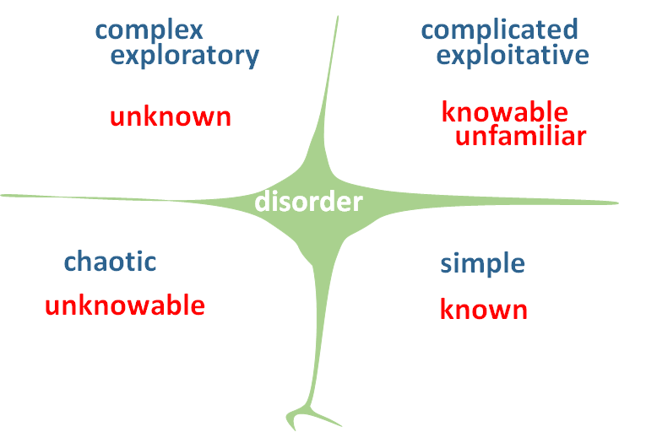
Cynefin
“Wise executives tailor their approach to fit the complexity of the circumstances they face”
probe sense respond
sense analyse respond
act sense respond
sense categorise respond
HBR: A Leader’s Framework for Decision Making; David J. Snowden and Mary E. Boone
Notes:
Our systems are complex
Sometimes simple standard prepared procedures; cause and effect known; Best Practice; “one answer”
Sometimes complicated can assemble practice drills together: with analysis, cause and effect are knowable. Experts. Risk of no innovation. There are options. Good Practice.
Sometimes complex have to invent new procedure: no known or analytical way to link cause and effect; emergent patterns; ecosystems, weather, knowable in retrospect.
Sometimes chaotic need reflex unthinking kata: Just act, based on experience, and drilled capabilities; Leader communicates and takes control
The IT use case covers all of these scenarios

Slide 4
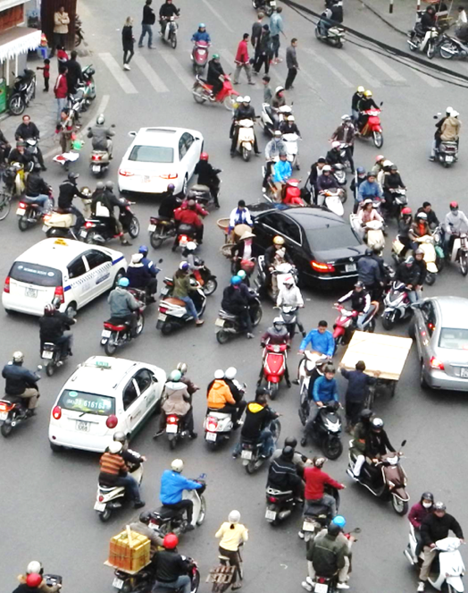
Complex systems
Cannot be fully described
Cannot predict future state
Cannot repeat results
Cannot predict emergent behaviours
Cannot explain all phenomena
Are adaptive

Slide 5
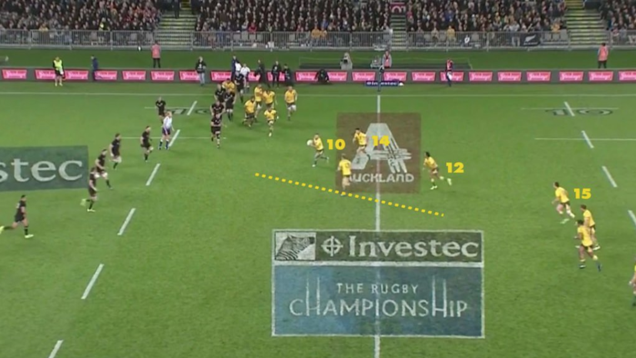
Context Drives Value Delivery
Drilled Capabilities + Variation & Experimentation =
“Value Network”
Pre-determined, Standardised & Inflexible “Value Stream”
https://www.rugbypass.com/news/analysis-one-passage-play-sums-differences-blacks-wallabies/
Notes:
Purpose and So what:
Cynefin is useful here: All Blacks in Complicated; Wallabies try to use play based more in Simple
AB able to adapt when necessary, not bound to a set play
Operating Framework: Freedom within Frameworks (a term I am hearing around the traps): the ‘so what’ is the temptation to over-simplify the complicated and complex
Culture (Intangible)
AB play for so something bigger than themselves; “The Jersey”
Servant-Leader
Clean the dressing room (Ego)
Strategy
Scenario Planning

Slide 6
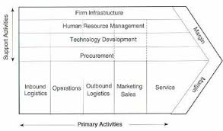
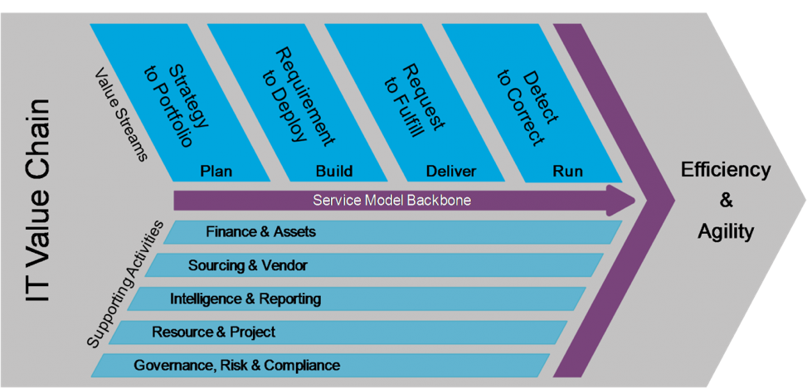
Value Chain tells part of the story
Manufacturing
IT Value Chain (IT4IT Reference Architecture)
http://www.opengroup.org/it4it
Notes:
Pros of the Manufacturing Paradigm: Porter and TPS
Focus on (strategy to) portfolio-led product or service
Helps visualize Left-Right flow in Value Streams
Suits deterministic activities (e.g. widgets, products) that can be automated
You need this for measuring flow / constraints (bottlenecks, time to value)
Guardrails depending on the context / degree of complexity (use Cynefin)
Cons
Static, Linear, mechanistic model
How do you account for the dynamics of roles and social interactions in creating value?
Systems are in flux to their environment
Cross-Value Stream orchestration & governance?
Learning, Experimentation and Problem Solving are Capabilities
Why don’t people follow process?
IT4IT Reference Architecture – key point: uses Value Chain construct; describes core capabilities, artifacts and information flows.
* What is the starting point of S2P (I am thinking that you cannot value stream Strategy)

Slide 7
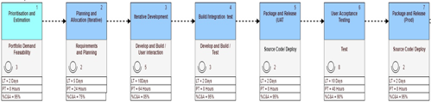
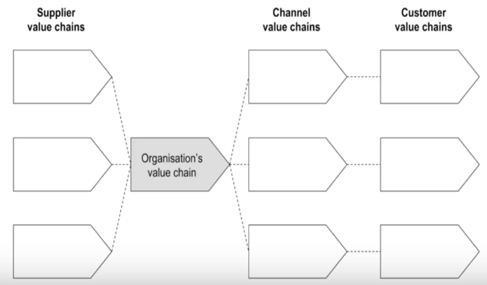
Zoom out
Gather all the Value Streams in the Value Chain
Analyze Dependencies (e.g. roles, knowledge, deliverables)
Then in the ecosystem…
MeanThat (Youtube)

Slide 8
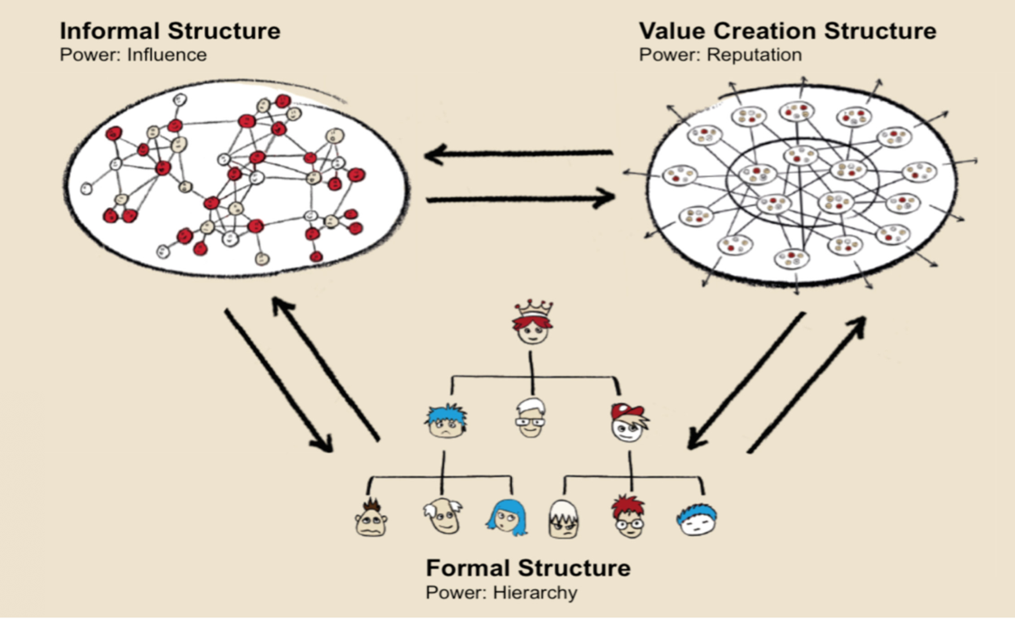
Three org structures
Organizational robustness comes from the quality and quantity of the inter- connections between humans and teams
Niels Pfläging, https://www.workpath.com/en/magazine/how-a-triad-of-organizational-structures-allows-to-absorb-complexity/
Notes:
Purpose and So what?
How is value actually created:
Formal Structure – Compliance structure, reporting, accountability, pay, whose the boss! But this doesn’t actually get work done.
Informal Structure – Its who you know. But this doesn’t actually get work done.
Value Creation Structure - Value is created by individuals and teams that have mastery to get the job done – Flexible work
There is a focus on ‘cells’ or teams (rather than individuals)
Teams organise around work to be done, problems to be solved
Decision making is close to the work being done (very Lean)
Periphery (Market focussed/facing) vs Centre (corporate / shared services) that only SERVES the periphery to create value.
HOW
Promote a result-based achievement culture
Promote self-development and mastery
Cultivate principles, not rules
Simple/few principles > Complex behavior Complicated/many rules > Stupid behavior
Focus leadership work on the system. Not on individual people.
Practice radical transparency
Make targets, measures and compensation “relative“
Let purpose drive behavior, not numbers or manipulative and controlling processes

Slide 9
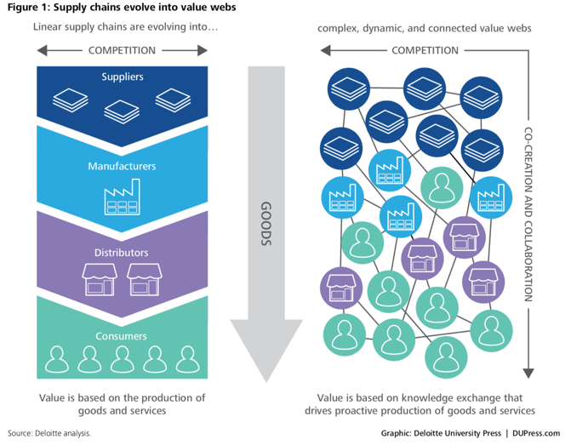
Value “Web”
influence will need to be achieved across increasingly complex networks—through relationships, collaboration, and co-creation
Knowledge flows
Learning
Collaboration / co-creation
Value networks – use cloud, social, IoT, 3D
Platforms connect parties (eg market places)
Talent sourcing
Ecosystem mapping & scenario-based war rooms
Supply chain traceabiltiy
Supply chain needs to self-organise (be resilient)
Shared training with suppliers
Experimentation
'Nowcasting’ using realtime social data
Dynamic state of federalism (central vs local)
https://www2.deloitte.com/insights/us/en/focus/business-trends/2015/supply-chains-to-value-webs-business-trends.html
Notes:
https://www2.deloitte.com/insights/us/en/focus/business-trends/2015/supply-chains-to-value-webs-business-trends.html
In ecosystems, influence will need to be achieved across increasingly complex networks—through relationships, collaboration, and co-creation

Slide 10
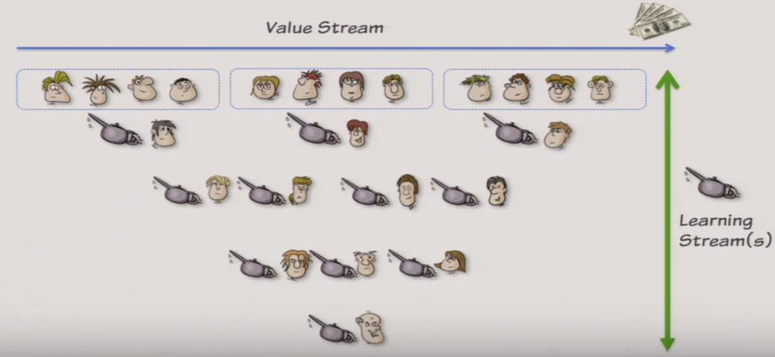
Learning is the special glue
Claudio Perrone: Beyond Value Stream: https://www.youtube.com/watch?v=DaBWecCBbiQ&list=PLhfub_vYh8sI0dxxbLwBRmJ8W-alekPv8
Notes:
Claudio Perrone says:
Learning
Experimentation
A3 Thinking

Slide 11
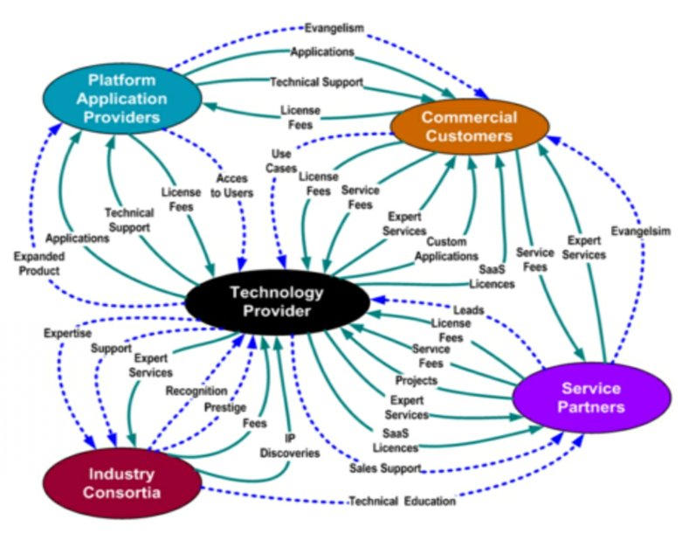
Value network
A value network is a set of rules and interactions that generates a specific business, economic, or social good or outcome through dynamic exchanges of tangible and intangible value
Verna Allee
Notes:
Verna Allee says:
Roles before processes
Interactions
Knowledge
Value Networks: Purpose & So what:
Encourages/Drives: non-linear thinking (you start with roles and the activities and deliverables they provide to each other; do not start with sequencing); it’s a pattern visualisation method for distinguishing tangible and intangible deliverables (sidebar/non-contractual (ie not a value stream deliverable) extras that keep the value stream running smoothly – so what: why is this required, it’s a workaround, or should it be formalised?)
Needs to start with a clear purpose statement: “find better ways to leverage feedback to improve product development”
How should Value Networks be resourced? Are there informal bottlenecks?
Like all mapping exercises: provides insight and communication
The ‘next step’ analysis then gets into spreadsheet analysis
Examples of intangible deliverables: a website that provides reference information
Examples of issues surfaced: (1) intangible knowledge that “dead-ends”; (2) information flows that are ‘one-way’ (same as knowledge example); (3) opportunity to convert intangible knowledge products into a revenue producing value add.
Media: morphed from uni-directional (newspapers, tv); to multi-directional (blogs, youtube, social)
Commercialisation of Research: focus on the roles (not individuals): get the right capabilities into roles, use partners more effectively, surface talent gaps
Requirements of entering new markets (or with new products?)
Analysis of value of roles; degree of role coupling
Multiple pathways in a network means that the context drives the optimal flow
Map how it really works, not how its supposed to work

Slide 12
People
Adaptive Universe & Graceful Extensibility – needs Responsible People (David Woods, The Mystery of Sustained Adaptability)
Not constraining people to only their role
Learning
Ironically, our increasingly automated systems have increased the demand for thoughtful, skilled, and skeptical human experts capable of understanding them and intervening, often under intense pressure and high uncertainty (Richard Cook, Working at the Centre of the Cyclone)
Notes:
David Woods: https://www.youtube.com/watch?v=7STcaWjJoww
Richard Cook: https://www.youtube.com/watch?v=3ZP98stDUf0&t=5s

Slide 13
Three Key Take-aways
Understand Context: Ecosystem & Cynefin for your Portfolio
Keep Mapping: Value Chain & Portfolio, Streams and Networks
Build Capabilities & Scenario Planning
Notes:
You need both Value Chain (product/service value) and Value Network (intangibles, value based on person-person interactions)
Map and drive out waste; solve problems – continuously; learn
Scenario plan; identify and drill capabilities
Adaptive Universe & Graceful Extensibility – needs Responsible People (David Woods)
Not constraining people to only their role
Learning
Creating Gaps is a challenge

Slide 14
End
Are you curious?
Rob England
Two Hills
@theitskeptic
Mark Whiting
ValueFlow
@markwhitingau

